Slide 1




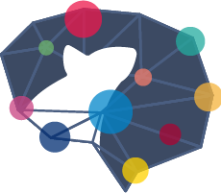




Notes:
Sage Bionetworks is a health research non-profit. We share data, expertise, and tools with researchers around the world to help them make reliable discoveries faster.
**click**
Sage has dozens of projects in the works. Out of these projects, I’m most familiar with those represented in the AD Knowledge Portal, which is geared towards finding a treatment for Alzheimer’s Disease.
**click**
Many different Programs have contributed data to the AD Knowledge Portal to the tune of more than 25,000 specimens from 8,000 subjects, with more data coming in every month. It's a lot of data, and this is only one dataset that we manage! Needless to say, we've needed ways to scale time consuming tasks such as data curation.

Slide 2
Hey, I want that app!
Designing Contagious
Shiny Apps
Nicole Kauer
Bioinformatics Engineer
Informatics & Biocomputing | Sage Bionetworks
Notes:
Many of our teams at Sage have turned to R Shiny for building these tools to scale up our work. Over time, we have learned a great deal about how to make Shiny apps that I would consider contagious; these are the types of apps that are demoed during a meeting and hands start clambering for the keyboards or microphones to ask how they can use the app for their work, as well. Today, I am going to share with you some of the packages, tools, and other tips we have learned, in hopes that you will try out some of them when you design your next contagious Shiny app.
My name is Nicole Kauer and I am a Bioinformatics Engineer at Sage Bionetworks. To help set the stage for this talk, I’ll do a quick overview of the main apps I’ve worked on, dccvalidator and its sister app dccmonitor.

Slide 3
Metadata
IndividualID | SampleID | isMale | ageDeath | ... | organ | tissue | platform | rin | ...
participant1 | p1_spec1 | 1 | 78 | ... | brian | puffs | HiSeq2500 | 9.2 | ...
participant2 | p2_spec1 | 0 | 93 | ... | brain | kleenex | HiSeq2501 | 8.7 | ...
Invalid capitalization Invalid keys Invalid values Ages > 90
Misspelling Excel click-n-drag
Notes:
These apps are primarily for metadata validation. You can picture metadata as a set of data about an experiment, with one row per specimen, containing all the information specific to that specimen.
**click** The problem is that it’s very easy to make mistakes and hand curating this data is unscalable. Let’s take a really quick look at how these apps have helped the Data Coordination Center, or DCC for short, scale up their work.

Slide 4
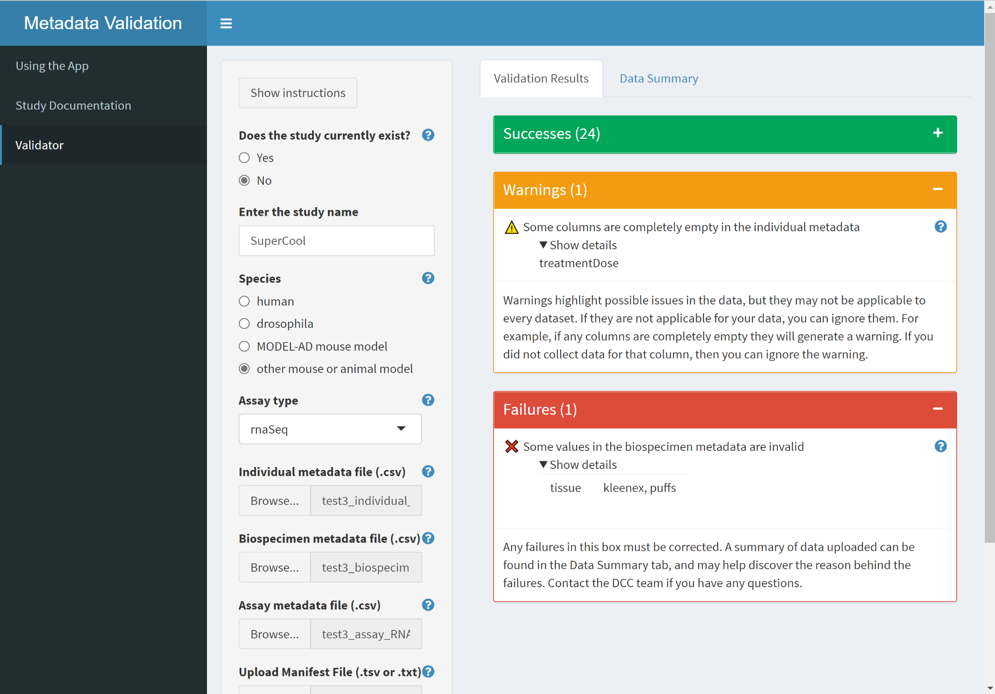
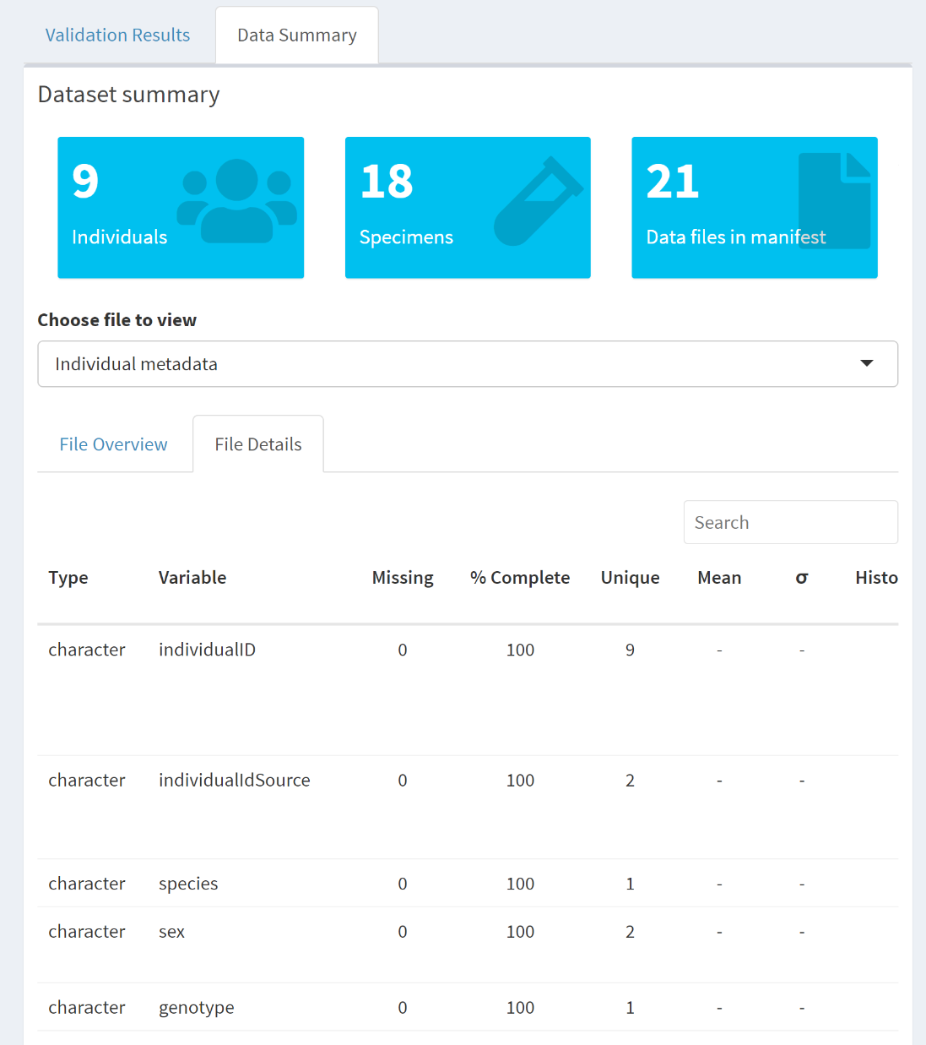
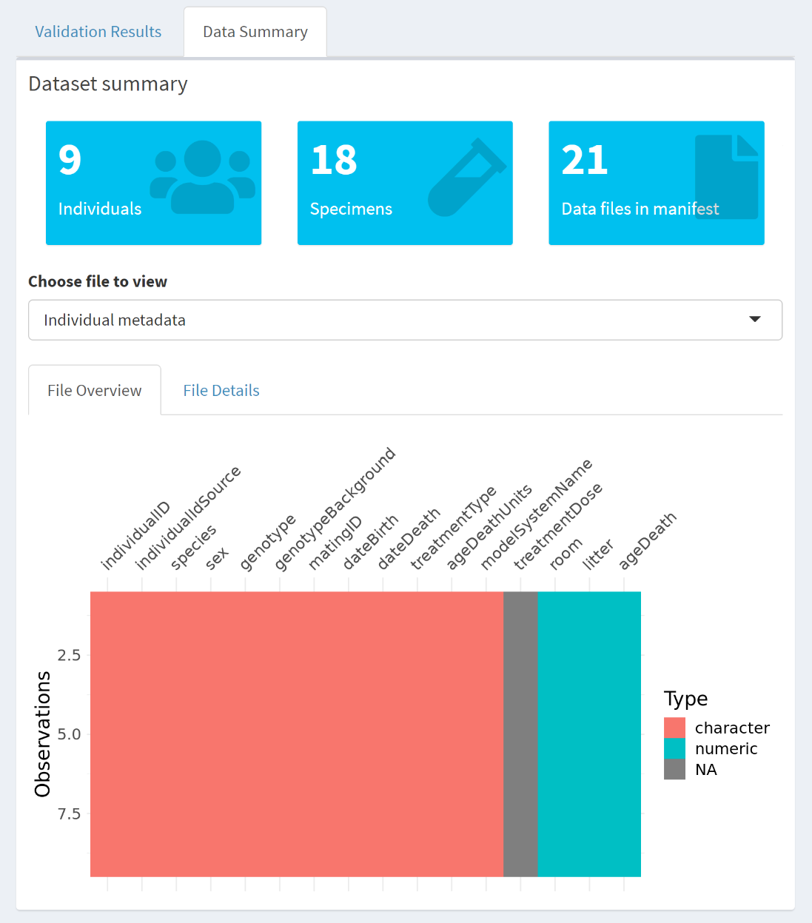
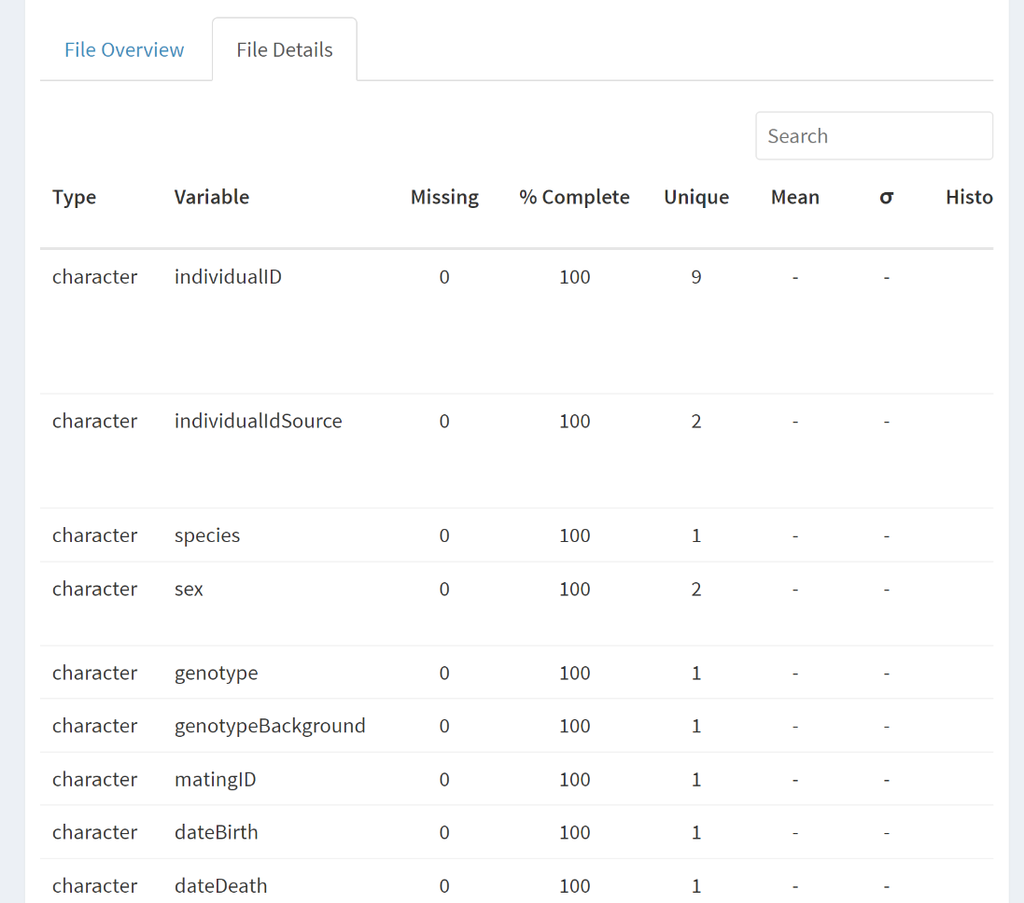
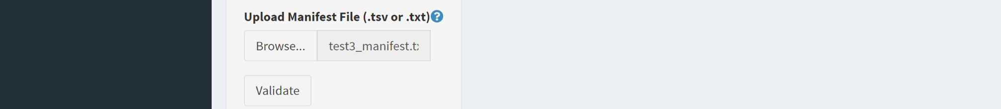
dccvalidator
study name
individual
biospecimen
assay
manifest
Notes:
Instead of curators checking data manually, dccvalidator puts the curation process back in the hands of the contributors.
**click**
They tell the app the study name associated with their metadata and a few other things.
**click**
They then upload their metadata the app as four files that can be joined to create that full metadata set.
**click**
They can then click the Validate button at the bottom and get a series of results. For anything that needs to be fixed, they get information on what the problem is.
**click**
There also a data summary tab,...
**click**
which tab gives an overview of the data submitted and is used as a sanity check. At the bottom, there’s a couple ways to see the data in the files. The first is a colorful way to see the data types and if anything is missing.
**click**
And we can get a deeper look by clicking on the details tab,...
**click**
which will show a summary of each column in the table.
So great, the contributors have a way to check their data themselves, but what if they run into issues...

Slide 5
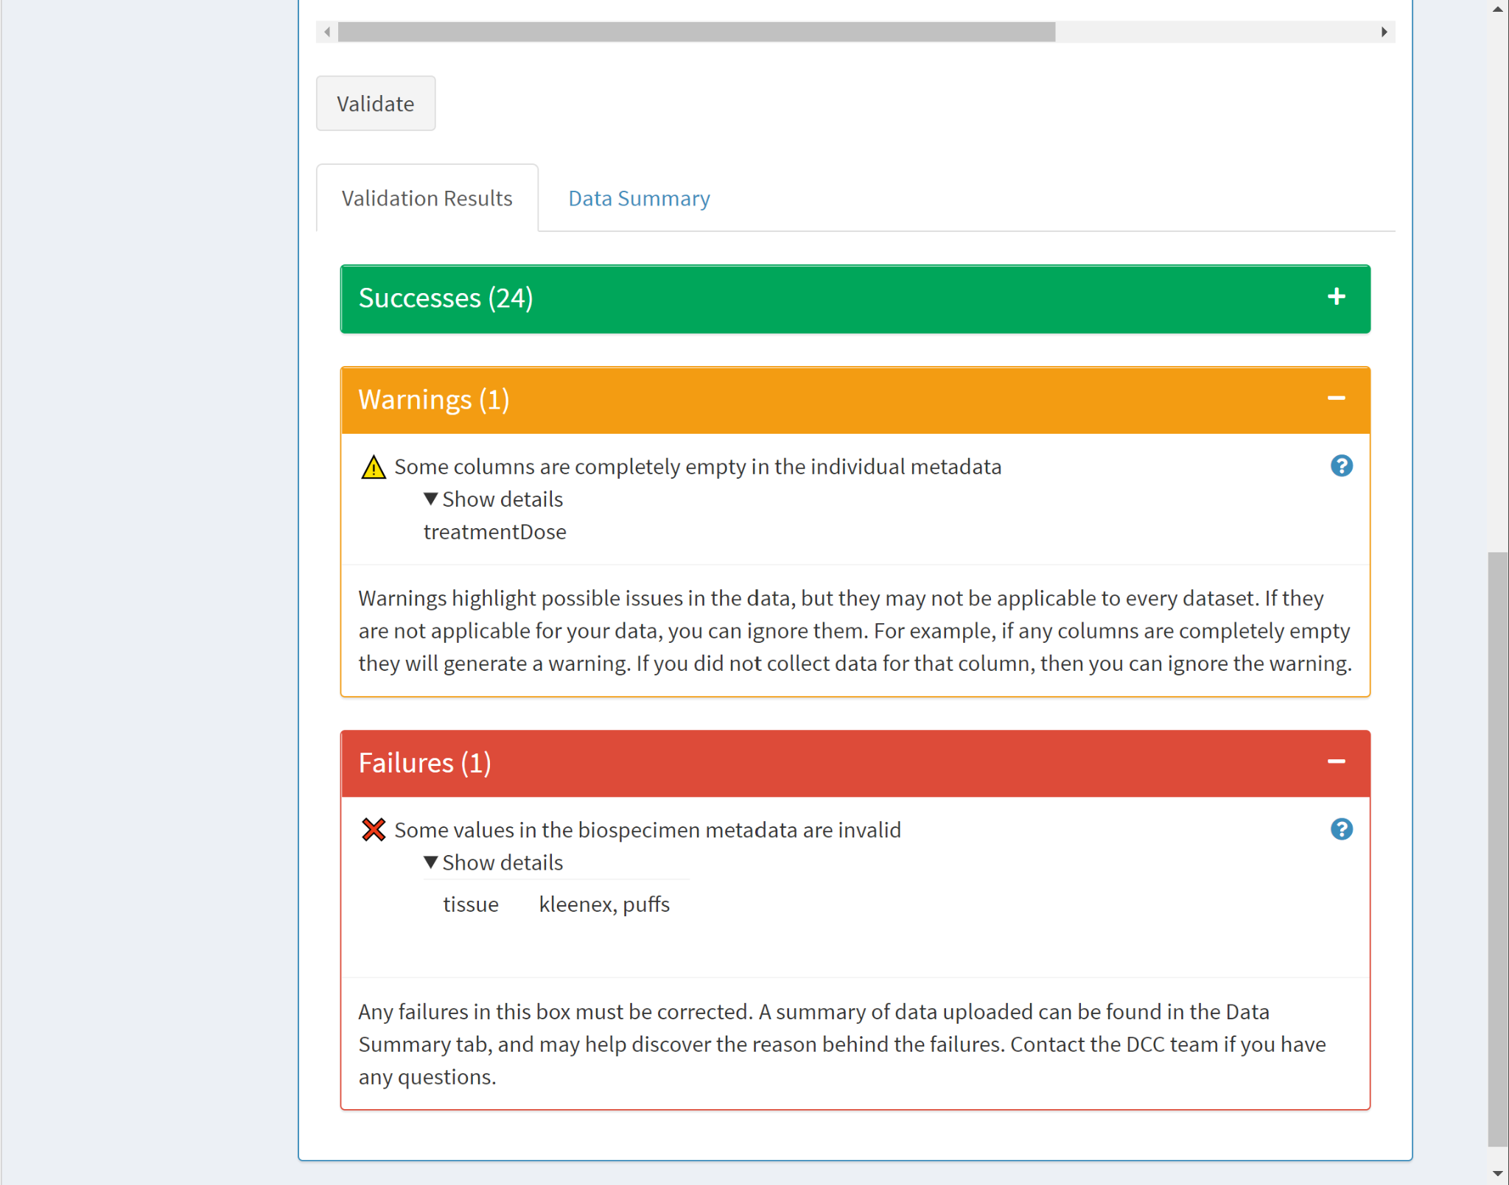
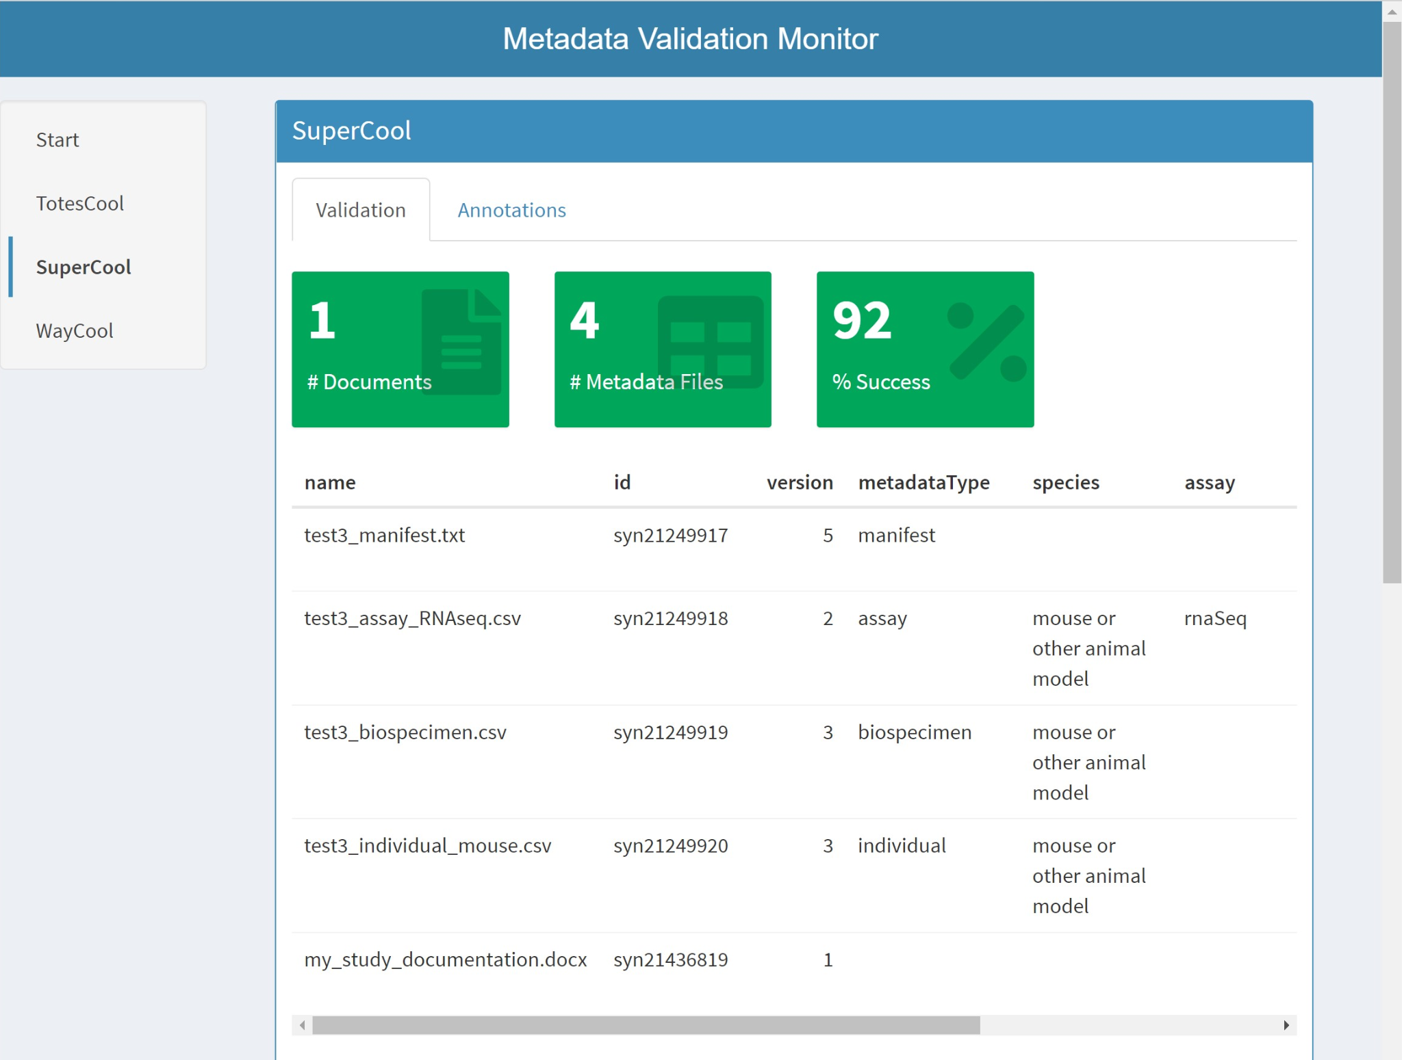
dccmonitor
study name
Notes:
This is where dccmonitor comes in -- it gives curators a way to check in on progress.
**click**
All metadata is grouped by study name.
**click**
The display section is a bit long and wide so I can’t show it all. This first part shows an overview of the files submitted, including the contributor’s current validation score.
**click**
At the the bottom, there are the same features seen in dccvalidator so that a curator can have access to all the same results and information that the contributor sees. In the interest of time, I’ll skip the extra features in these apps.
These applications were initially created for the groups contributing data for the AD Knowledge Portal, and have been hugely successful for scaling up curation of that data. They’ve decreased the time needed to curate a single set of metadata from hours to minutes.These apps have also spread to others. Some groups are using customized versions of the apps, while others are using the underlying functions to help out with miscellaneous, day-to-day, curation tasks.

Slide 6
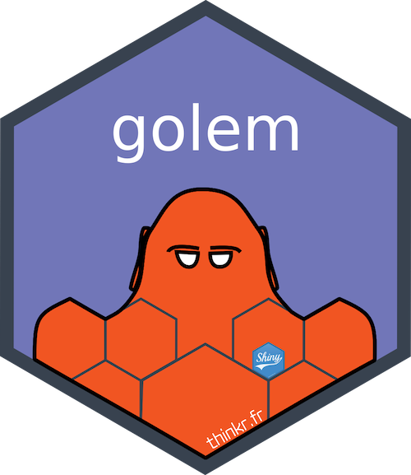




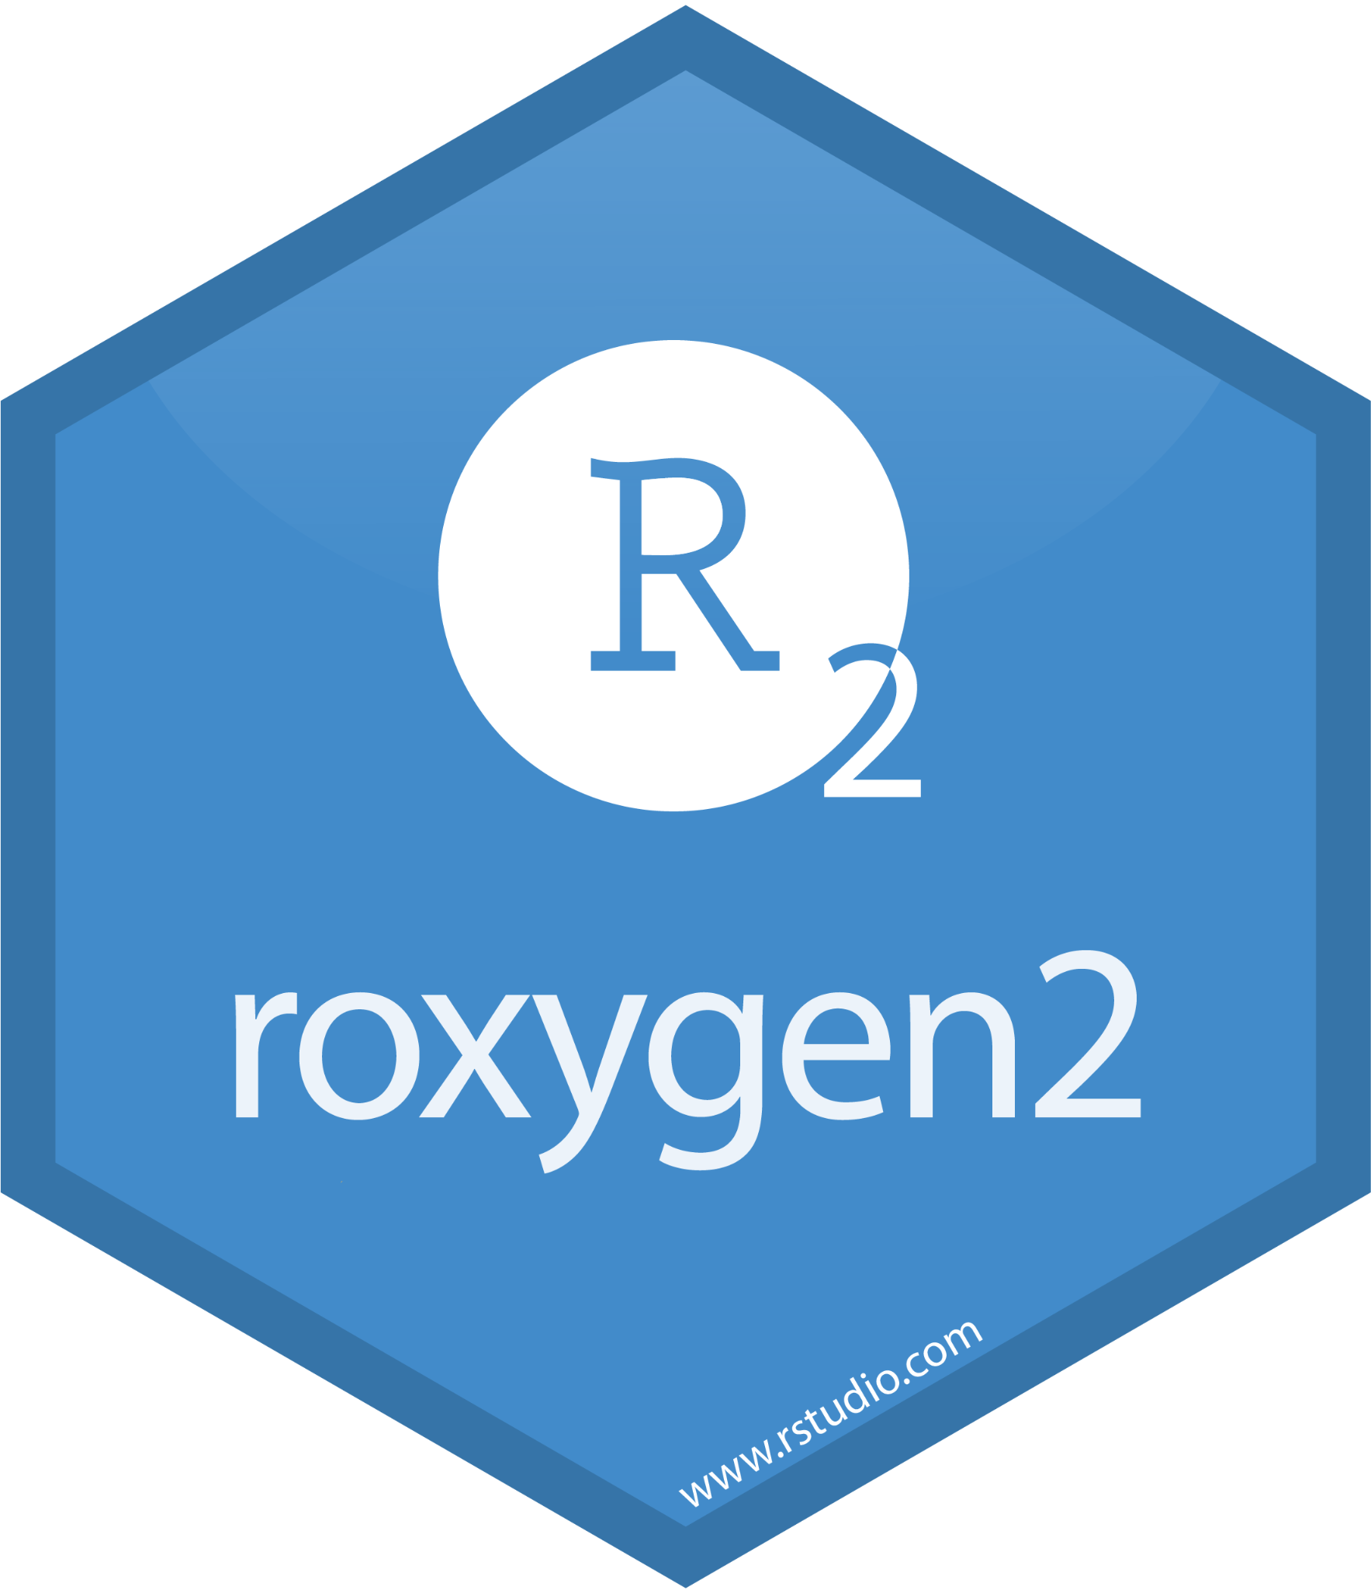

SPREADABLE
ADAPTABLE
RELIABLE
DESIRABLE
foundation
app design
hard work
adding context
deployment
#TIL Sard is a type of brown-red quartz
Notes:
In the development and maintenance of our Shiny apps, there’s been four main points that I’d say have led to them being contagious:
**click**
They are easily spreadable. This comes down to app organization, environment control, and documentation.
**click**
They are adaptable because they were designed to be.
**click**
They are reliable because they’ve been tested.
**click**
And they are, of course, desirable.
We are going to use dcc apps as a guide for discussing tools and tips for implementing these four ideas.
**click**
Before we do, a quick note is that these letters spell sard, which is a type of brown-red quartz that can, of course, be made shiny. I collect rocks and minerals and this is a shiny talk so this acronym makes me happy.

Slide 7
Spreadable
Notes:
So what do I mean by spreadable? Anyone who has dealt with sharing code, especially Shiny apps, should have come across some of the less fun things about this process. Potential collaborators or users might not have the right version of R or the right packages or maybe even the knowledge of how to package up and run a Shiny app at all. In short, what I mean by spreadable is that it should be as easy as possible to get and get running. Let’s look into some ways that this can be simpler.

Slide 8
an opinionated framework for building production-ready Shiny apps
dccvalidator
inst/
R/
app-ui.R
app-server.R
...
DESCRIPTION
app.R
...
Engineering Production-Grade Shiny Apps
install.packages(“dccvalidator”)
library(“dccvalidator”)
run_app()
Spreadable
Adaptable
Reliable
Desirable
Notes:
I’m sure many of you have probably heard of the Golem framework for Shiny apps. There’s enough to the framework to literally fill a book, which is linked here. The main benefit of this framework is the idea of creating the app like any other R package, which then opens your app to the wide world of package tools. Many of the tips here all build on this framework.
**click**
Dccvalidator is an R package and its codebase looks like one. Throughout this talk, I’ll emphasize any codebase additions from these tools as orange in this structure.
**click**
The package is on cran so I can use the traditional install.packages to get it on a machine, load the library, and run the app. When I’m developing the app, I can use the handy devtools::load_all to get my local development version of the package loaded at once and test out new features I’m building.
This works with collaborators who want to use the app, as well. The code is on GitHub so they can clone the repository to their local machine, make any alterations they need, load the library, and run their own version of the app. Keeping the app in a package format helps keep the code organized and easier for contributors to locate what they are looking for within it.
A package, in general, is easier to pass to someone than a bunch of seemingly random files that have to be used in specific ways or sourced directly. Using the Golem framework idea of packaging up your Shiny apps will help increase their ability to spread to others.
.

Slide 9
dccvalidator
renv/
inst/
R/
app-ui.R
app-server.R
...
DESCRIPTION
app.R
renv.lock
...
...any of your existing workflows should just work as they did before
Introduction to renv
renv::init()
renv::snapshot()
renv::restore()
Spreadable
Adaptable
Reliable
Desirable
Notes:
Wrapping up your app in an R package doesn’t necessarily help with differences in package dependencies between one machine and another or even on your own machine from one moment to another. While golem makes your app easy to install, it doesn’t keep the same versions of packages with your app. Having your app break immediately on install is the opposite of a spreadable app -- no one will want to deal with the hassle of figuring out why your package isn’t working for them.
renv is used for package management and is a great way to control your app’s dependencies, which is especially important for development with collaborators and launching the app on a server. Locally, renv will create a new folder for your package dependencies and set out their specific versions in an renv.lock file. We use this in our apps to control our package versioning and this makes firing up a new version of the application on our server super simple and, better yet, we know it will work.
**click**
What I like about renv is that it’s simple to set up and use. There are three main functions. Init will take stock of what your app is using and do the initial setup process. After you add or upgrade a package, you can just use the snapshot function to capture your latest development environment. If you need to reset your environment or are developing on a new system, use restore to get your app’s personal library up to date with where it should be.
While it takes some time to get used to using a package manager like renv, it makes it easier to for someone to choose to collaborate or even to use your app at all when they don’t have to deal with the minute details of package versions.

Slide 10
pkgdown
dccvalidator
man/
inst/
vignette.Rmd
R/
DESCRIPTION
NAMESPACE
README
app.R
...
roxygen2
pkgdown
github.io/.../reference/
usethis::use_pkgdown_github_pages()
GitHub Pages Action
Spreadable
Adaptable
Reliable
Desirable
Notes:
Easily spreadable apps have good, thorough documentation. For documentation, dccvalidator has a docs site hosted by github pages, vignettes that are specific to the package as well as imported into the app, a README with general information, and more.
**click**
While Roxygen2 won’t write your function documentation for you, it can help keep the NAMESPACE file and man pages current for the functions that you have added documentation to.
**click**
Using your existing documentation, pkgdown will create a website to better surface the information.
**click**
My favorite part of pkgdown sites is the Reference guide, which lists all the exported functions in a clean, skimmable way. The package usethis has a handy function to help quickly create and push your website to GitHub pages, and there are GitHub Actions that will automatically update and relaunch your docs site when needed.
It’s hard to know what an app is or what its used for or why I would want to use it, if there’s no documentation. Documentation spreads the message about what your app is and why someone should take advantage of it.

Slide 11
Adaptable
Notes:
For a Shiny app to be contagious, it should also be adaptable. While the purpose of an app may be useful to many groups, it's doubtful that they will all want or need exactly the same app, even if the difference is simply changing one logo for another. It's really the functionality they want, but everything surrounding that functionality should adapt to fit their needs.

Slide 12
dccvalidator
dccvalidator
inst/
R/
app-ui.R
app-server.R
mod.R
...
DESCRIPTION
app.R
...
Spreadable
Adaptable
Reliable
Desirable
Notes:
One way to make an app adaptable is to take advantage of Shiny modules. Modules are like plug-and-play mini-chunks of your app that you can use once or over and over.
**click**
Dccvalidator has many modules and we already saw some of them earlier in the talk.
**click**
There are three modules on a tab I haven’t shown, including one for the entire tab and one for entering the study name which also used on the validation tab.
**click**
The entire tab section is a module,
**click**
as are the results boxes,
**click**
And the data summary features.
Designing your app to be modular will make it more adaptable to the needs of others. It’s quite possible that they even have their own app and just want a piece of yours -- if that piece is a module, it’s much easier to port into their app. In fact, dccmonitor uses some of the modules from dccvalidator.

Slide 13
default:
include-tab: TRUE
production:
include-tab: FALSE
dccvalidator
inst/
R/
app-ui.R
app-server.R
...
DESCRIPTION
app.R
config.yml
...
Introduction to config
Sys.setenv(“production”)
config::get(“include-tab”)
Spreadable
Adaptable
Reliable
Desirable
Notes:
A configuration file can help take your app to the next level of adaptability.
**click**
The best things about the config file is that you can have multiple versions of your app running and the only thing you have to change is what set of configurations you are pulling in at startup.
When combined with modules, a config file can be quite powerful. In dccvalidator, I was recently asked to remove a feature that was no longer needed for a group. Because the feature was already modular, instead of having to remove it for everyone who wanted to use the app, it only took about 15 minutes to make the feature customizable via the config file. Now anyone who wants to use the app can choose whether they want that feature or not by simply turning off that feature in the config.
Not only does design with a config file make the app easier to adapt, it’s proven vital to the success of our apps.

Slide 14
Reliable
Notes:
It's hard to get excited about using and adopting an app if it's buggy -- it just is. Designing your app with reliability in mind can help with adoption.

Slide 15
dccvalidator
inst/
R/
app-ui.R
app-server.R
...
tests/
DESCRIPTION
app.R
...
Testing your code can be painful and tedious, but it greatly increases the quality of your code.
testthat
my_func <- function(my_df) {
stopifnot(
inherits(my_df, “data.frame”)
)
...
}
Spreadable
Adaptable
Reliable
Desirable
Notes:
Adding tests for functions is incredibly time consuming, but completely worth it. While sometimes it can be tedious, especially when I need something done yesterday, it’s nice to be fairly confident that the code I’m writing is doing what I expect it to and nothing else.
**click**
Testthat is a package many of you have probably heard of. It works great for unit testing package functions. There are some packages for shiny testing, but given the challenges of testing user interfaces, I haven’t found one that I enjoy using, yet. For now, whether you do have a shiny testing package you like or not, I recommend breaking out anything that doesn’t absolutely have to be in a Shiny UI or Server function into its own function or better yet, a set of functions that can be tested with testthat.
**click**
However, for those of you who are familiar with Shiny reactives and trying to pass them to a non-Shiny function, I’m sure you know how challenging and frustrating it can be when you make a mistake and don’t unwrap your data from the reactive when passing. When developing a new function, you can add a stopifnot test at the start to make sure you are passing the right the variable. This can save time by helping you figure out if a problem is coming from the Shiny side or from the new function that you’re creating. I haven’t done this with dccvalidator, yet, since this is something new that I’ve learned, but I have been using this recently in other apps and for spot testing, and it has been a huge time saver.
The main point is that designing your app to be reliable by adding in testing will save everyone, both yourself and potential adopters, from a headache later on.

Slide 16
Desirable
Notes:
Contagious apps are desirable apps. The good news is that coming up with an app that would be desirable to multiple people is technically the simplest part. Everything else I've mentioned takes some thought, planning, and good old fashioned elbow grease to do, but this just involves some daydreaming...

Slide 17
metadata validation
notify contributor of errors
track validation progress
dccvalidator
dccmonitor
data sharing instructions
generate metadata annotations for files
Spreadable
Adaptable
Reliable
Desirable
Notes:
There are a lot of Shiny apps out there. Many apps are really cool and fun, but the big question is, what sets the contagious apps apart? From my experience, it’s the practical apps that are more contagious. These are apps that take tedious or repetitive tasks and make them doable with a click of a button. This is what makes dccvalidator and dccmonitor so contagious -- they decrease the amount of time needed for data curation and they do so by wrapping up many time consuming tasks into a simple interface.
Any task that saves a lot of time and has a visual element is potentially a good candidate for an app.
Contagious apps don’t have to be flashy or nice looking, either. I built dccmonitor when I was an intern at Sage and it is not the prettiest app out there -- but it’s useful and that’s the important part.

Slide 18
SPREADABLE
ADAPTABLE
RELIABLE
DESIRABLE
foundation
app design
hard work
adding context
deployment
Notes:
To sum up, to design a contagious app, design it around a problem or a set of problems to make it desirable. Maybe you’ve already done some of the hard work and have a set of functions you have developed. See if there’s a way to incorporate them into a one-stop, click-and-be-done action. Make those functions reliable with testing, and adaptable to similar but slightly different use cases. Then start building a simple Shiny interface around them, following the Golem framework idea of making a package, complete with documentation and package management.

Slide 19
Thank you
dccvalidator / dccmonitor
Kara Woo
Nicole Kauer
Kelsey Montgomery
Matthew Fazza
Sage Bionetworks Team
R-Ladies
Notes:
Finally, I want to acknowledge the creators and collaborators on the dccvalidator and dccmonitor, as well as thank the Sage Bionetworks team and the R-Ladies group for the practice talks and great feedback.

